Slide 1
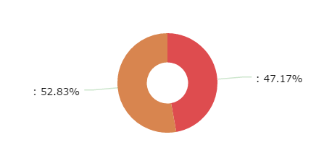
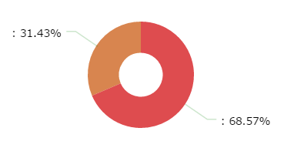
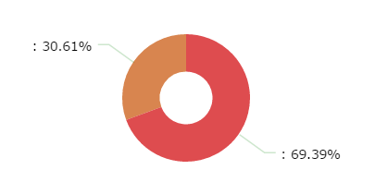
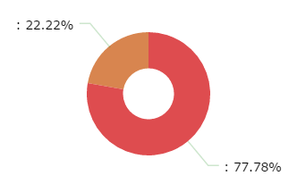
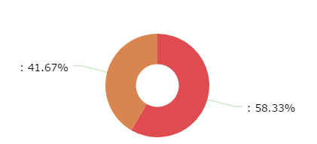
Americas (11/35 – 31%)
Europe (28/53 – 53%)
Africa (15/49 – 31%)
MENA (4/18 – 22%)
Asia Pacific (15/36 – 42%)
Regional breakdown of National Societies with a formal National Youth Policy Source: RCRC Youth Engagement Study Report

